Slide 1

Analysis of Energy Production
Team 6:
Panshul Saraswat,
Rutuja Lohakare,
Raj Mehta,
Rushali Naikoti,
Madhulika Vandana

Slide 2
Data Collection by EIA: Information is sourced from over 2,000 U.S. utilities.
Year of Data: The dataset encompasses energy statistics for the year 2017.
Energy Sources: Includes detailed sectors and distributors of energy.
Sector Usage: Breaks down energy use across various economic sectors.
Revenue Details: Provides data on revenues from the sale of electrical energy.
Introduction to Dataset:

Slide 3

Story Point 1:
Utilities Across the USA: Comprehensive analysis from Diversity to Dollars

Slide 4
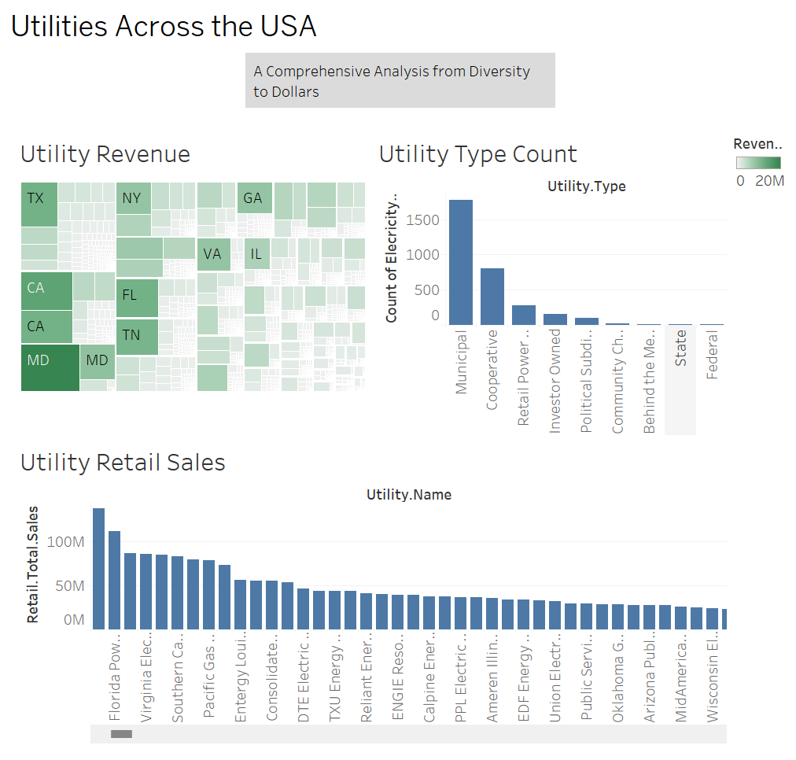

Slide 5

Story point 2:
Seasonal Peaks: Unveiling the Impact of Summer and Winter Demand on Utility Revenue Across States.

Slide 6
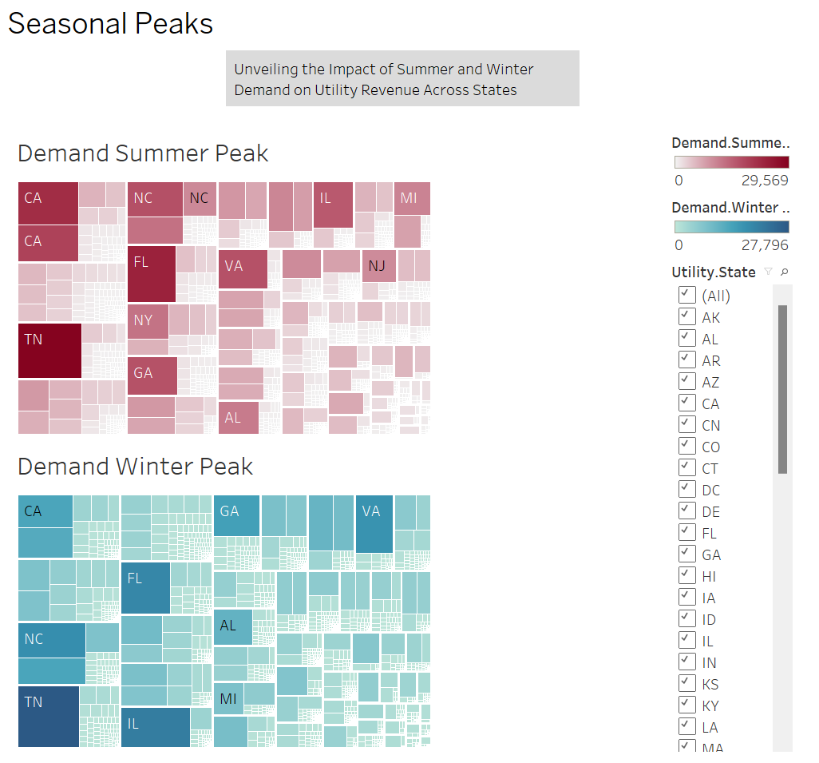

Slide 7

Story point 3: Sectoral Overview
Customer Segmentation: Distribution of customers across Residential, Commercial, Industrial, and Transportation sectors using a map or bar charts

Slide 8
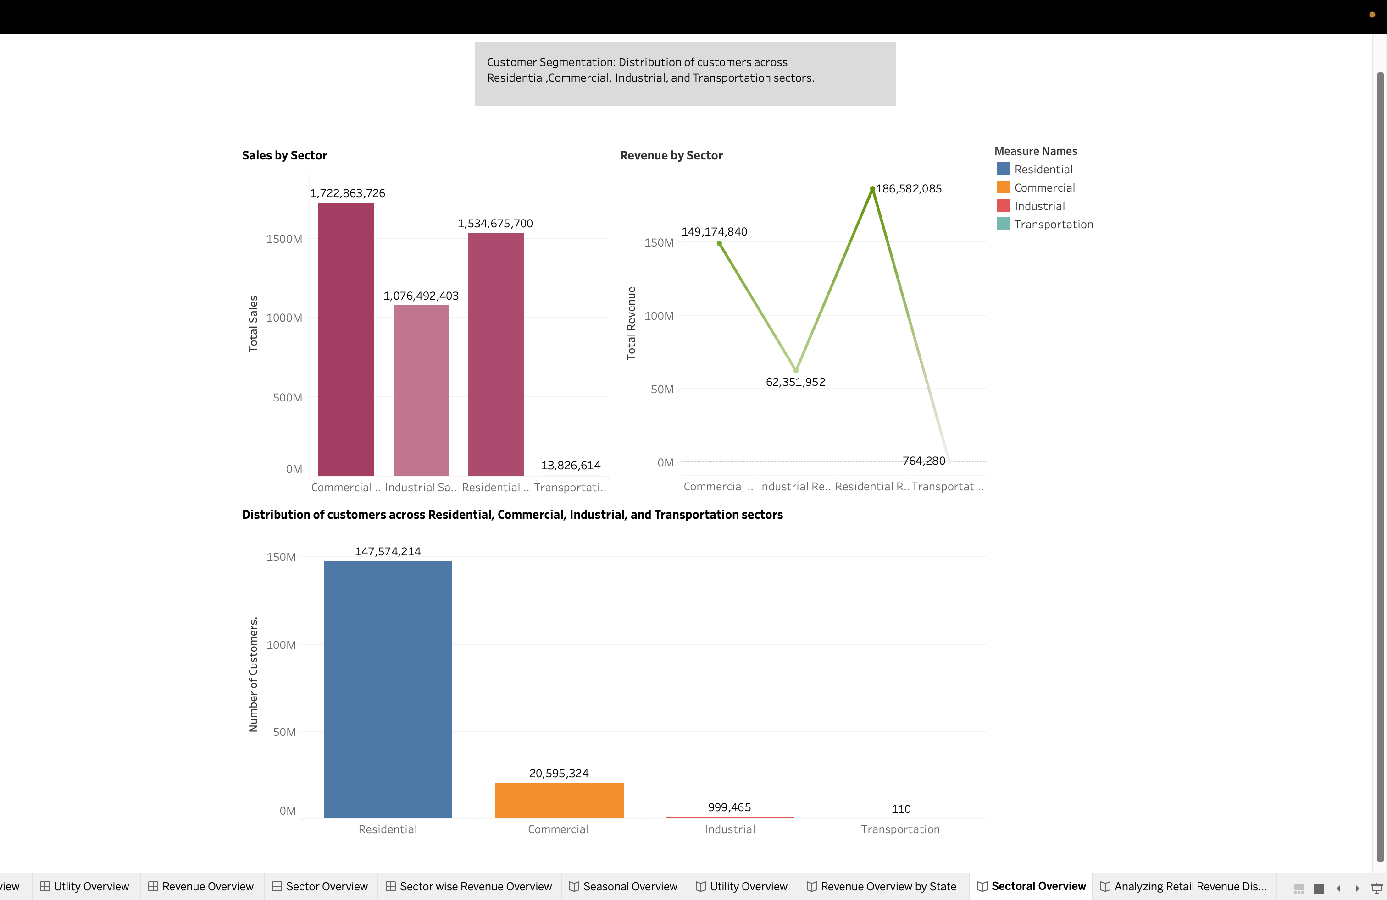

Slide 9

Story point 4:
Analyzing Retail Revenue Distribution and Trends Across Sectors

Slide 10
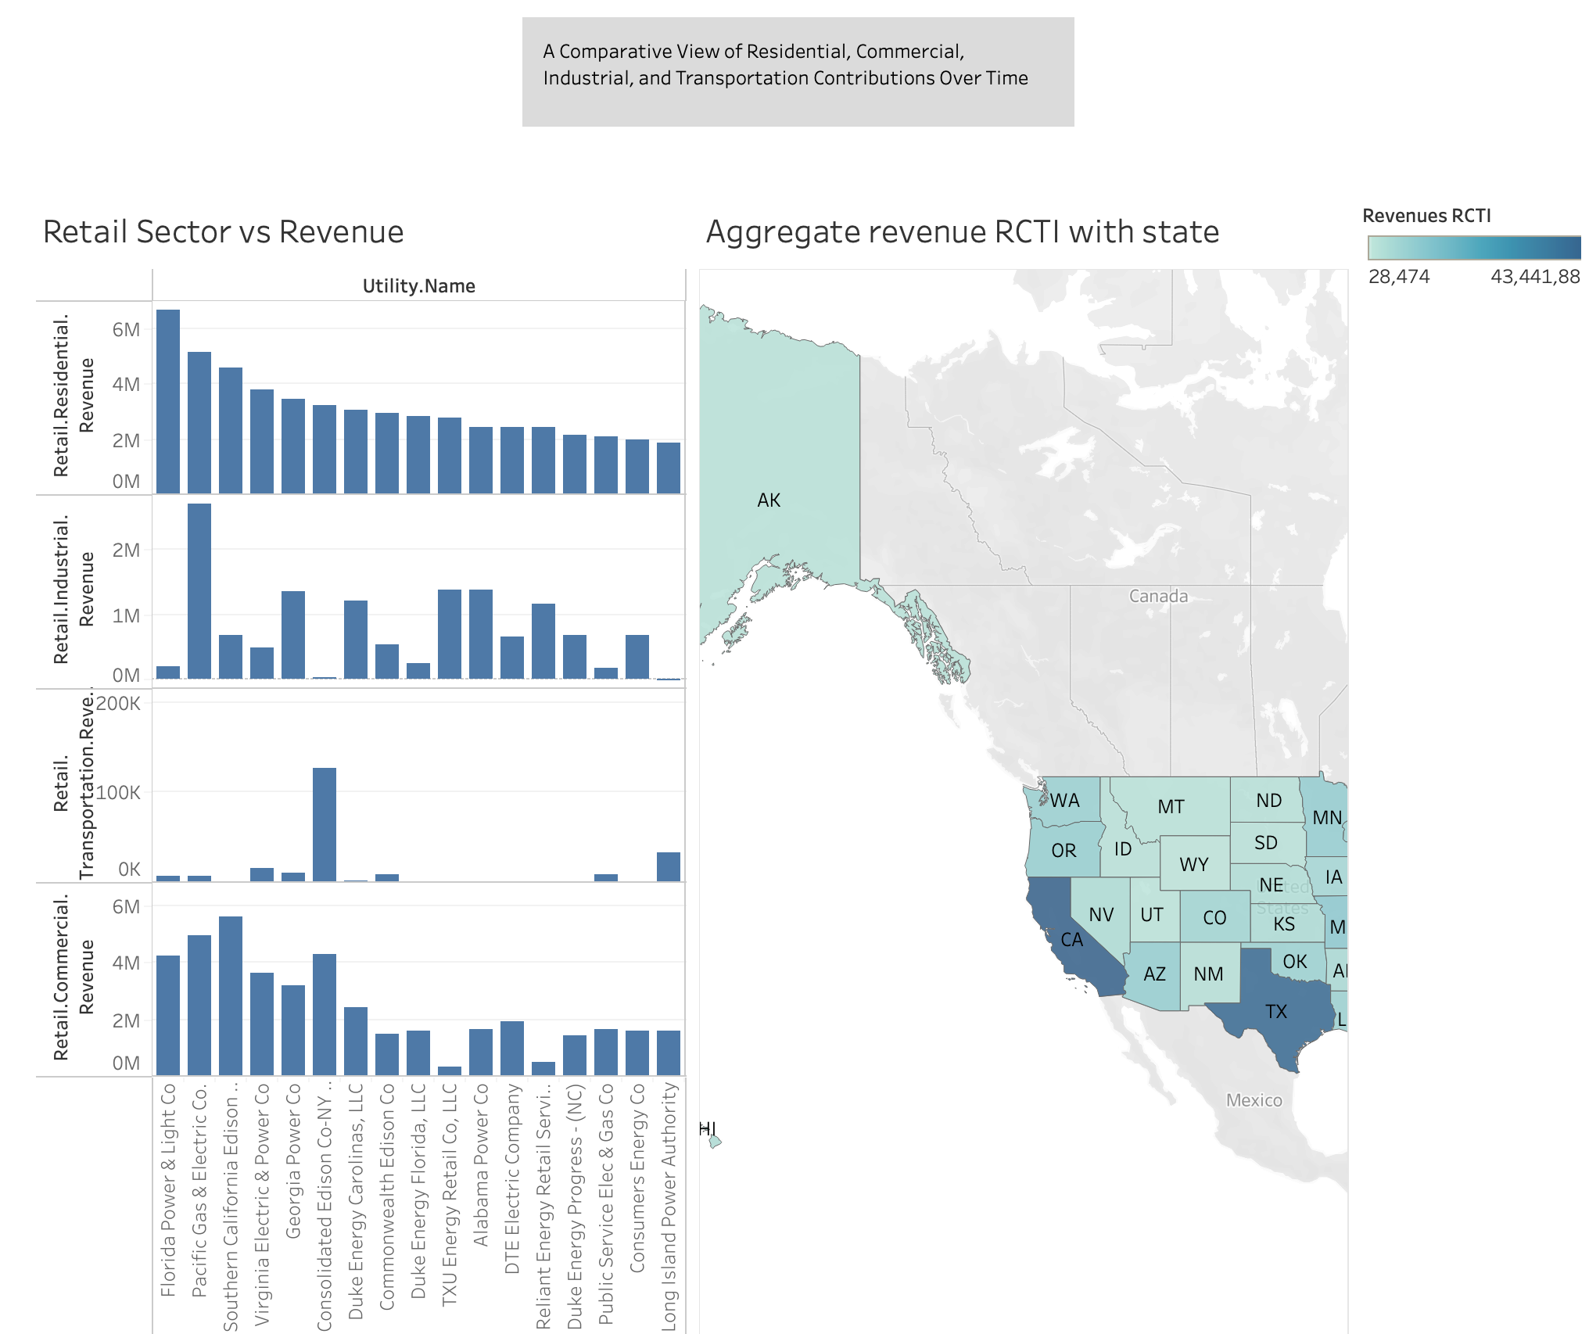

Slide 11

Story Point 5: Revenue Details
Revenue details with individual charts for Retail Revenue, Delivery, Resale, Adjustments, Transmission, and Other

Slide 12
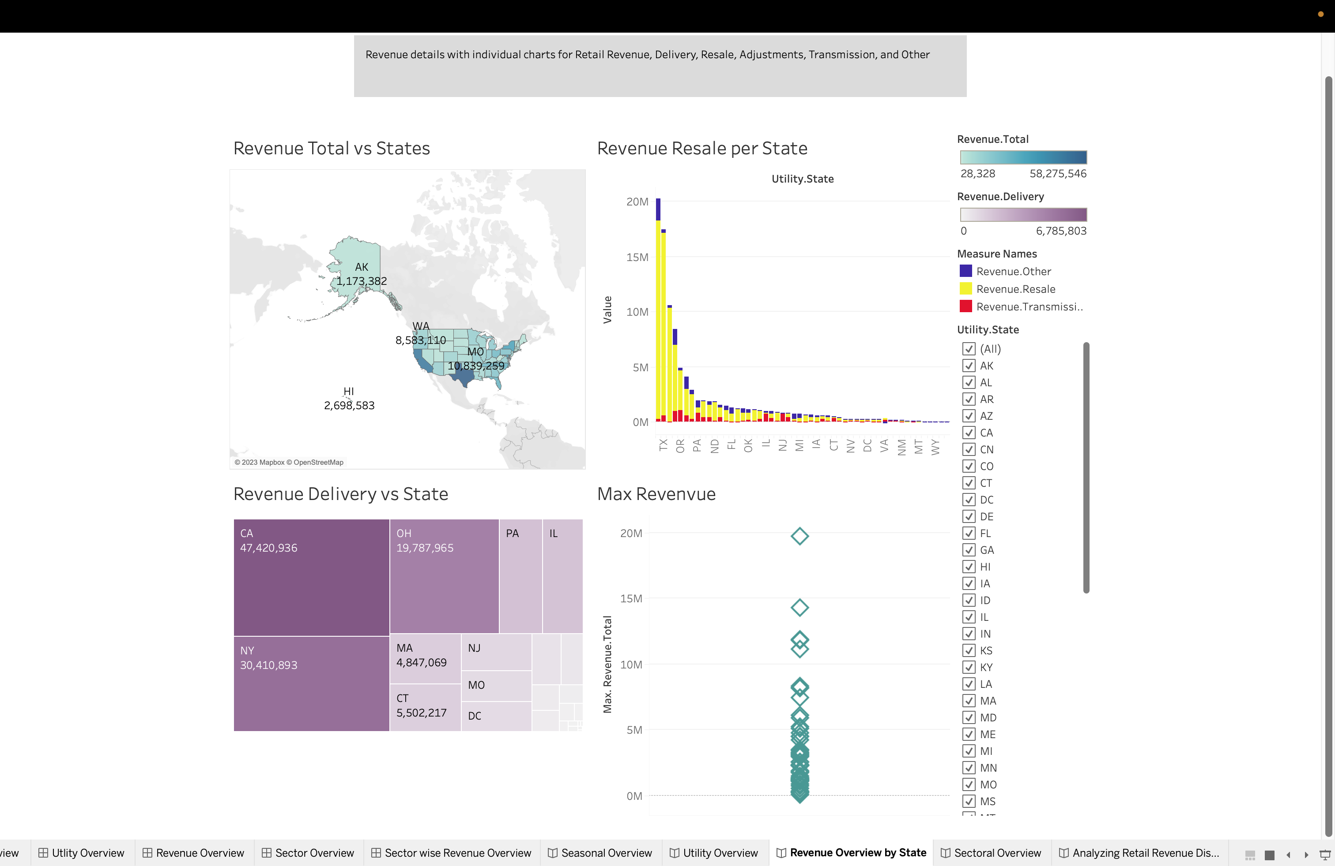

Slide 13

DATA PREPARATION

Slide 14
Steps Performed for Data Preparation:
Data Cleaning
Outliers Removal
Correlation Analysis
Ensured the duplicates and null values are removed.
Interquartile Range (IQR) method was used to remove the outliers.
Utilized Heatmap for finding relations between following variables:
Demand Summer Peak
Demand Winter Peak
Sources Generation
Sources Purchased
Retail Total Revenue
Retail Total Sales

Slide 15
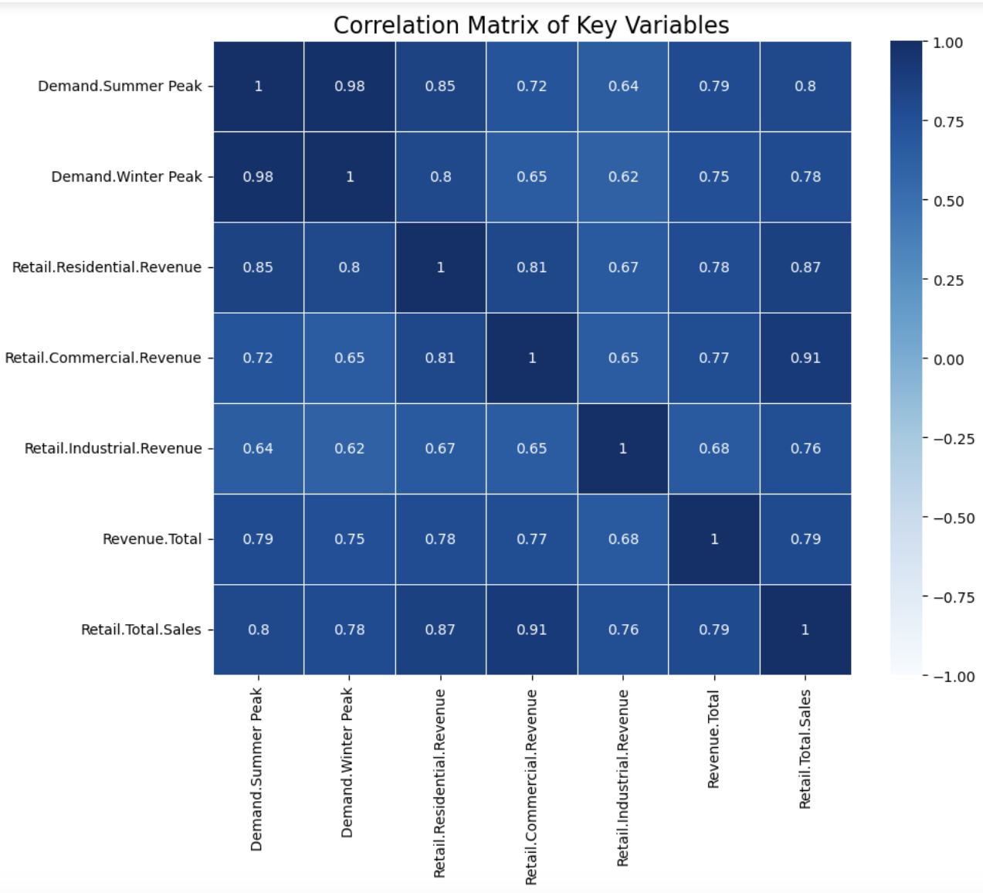
Correlation Analysis:
A strong positive correlation between Demand.Summer Peak and Demand.Winter Peak, with a coefficient close to 1.
Retail.Total.Revenue and Retail.Total.Sales show a substantial positive correlation with Demand.Summer Peak and Demand.Winter Peak.

Slide 16

MODELING AND EVALUATION

Slide 17
Energy Consumption as Per Hot and Cold Climate States
K Means Clustering
The data has partitioned into two distinct groups based on the similarity of their feature values.
The first cluster centroid has values [-0.08277522 -0.08200684]
The second cluster centroid has values [7.8786958 7.80555972]
T test comparison between 2 clusters:
t-statistic: -77.11780174932275
p-value: 0.00
Reject the null hypothesis
The substantial variation in energy usage between the cluster's points to the possibility that different utilities might need specific strategies for energy planning and demand management, in line with energy consumption.

Slide 18
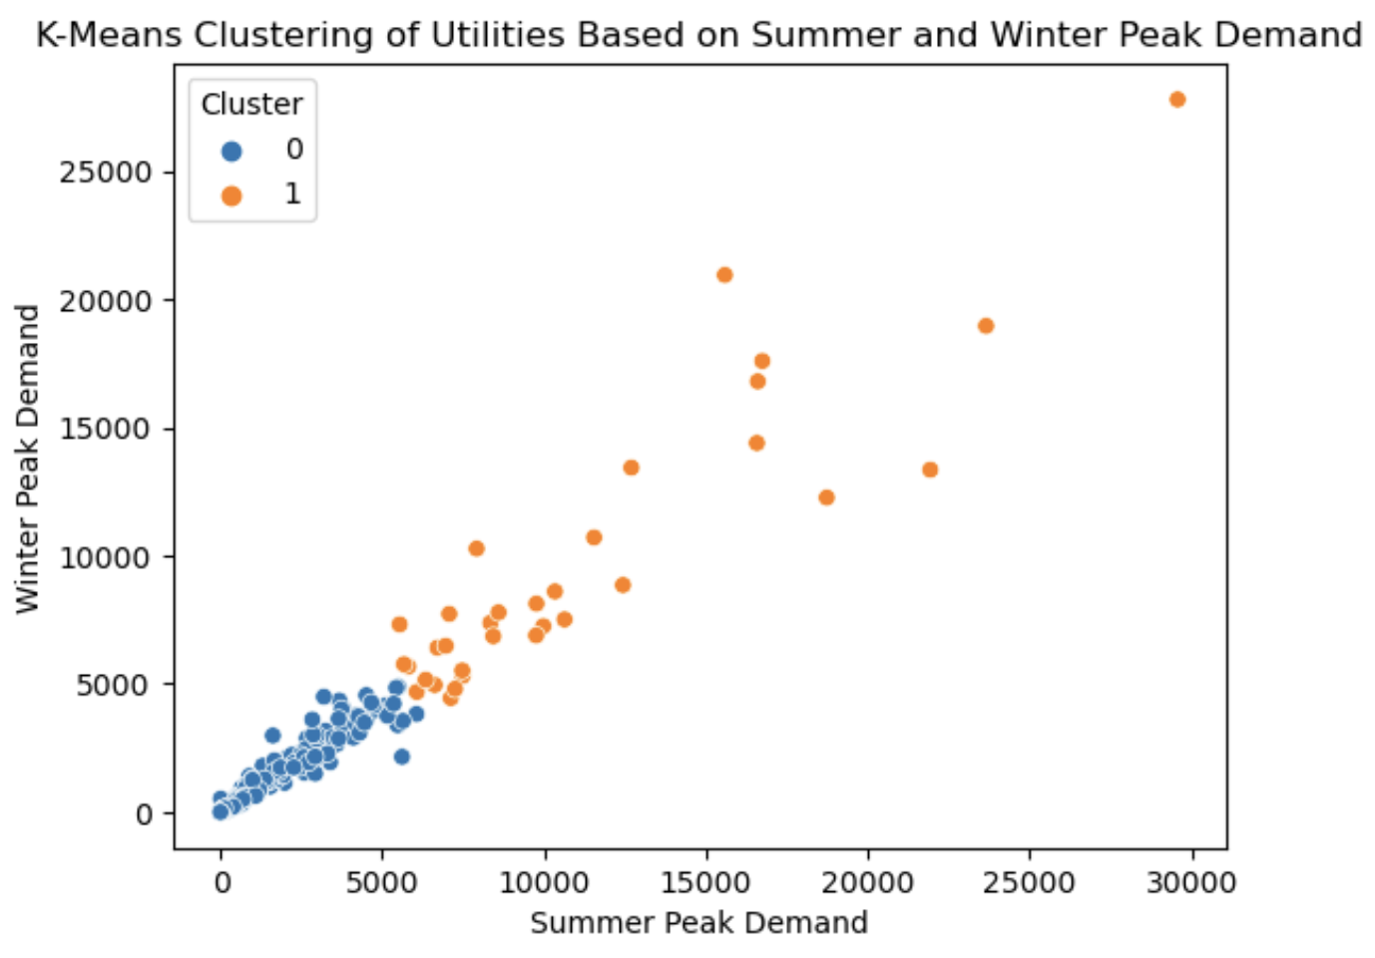
Cluster 0 (Blue): Utilities in this cluster have centroids indicating lower peak demands in summer and winter.
Cluster 1 (Orange): This cluster has centroids with high summer and winter peak demand values

Slide 19
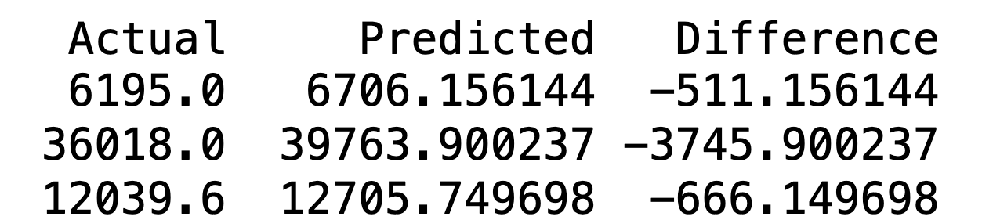
Peak Energy Demand Impact on Total Utility Revenue
Linear Regression:
Actual vs Predicted Revenue :
Predictor Variables:Demand.Summer Peak and Demand.Winter Peak
80% for Training, 20% for Testing
The R-squared values: Training data = 0.944
Testing data = 0.965
Utility companies can use these insights to make informed decisions regarding capacity planning, infrastructure investments, and demand-response programs.

Slide 20
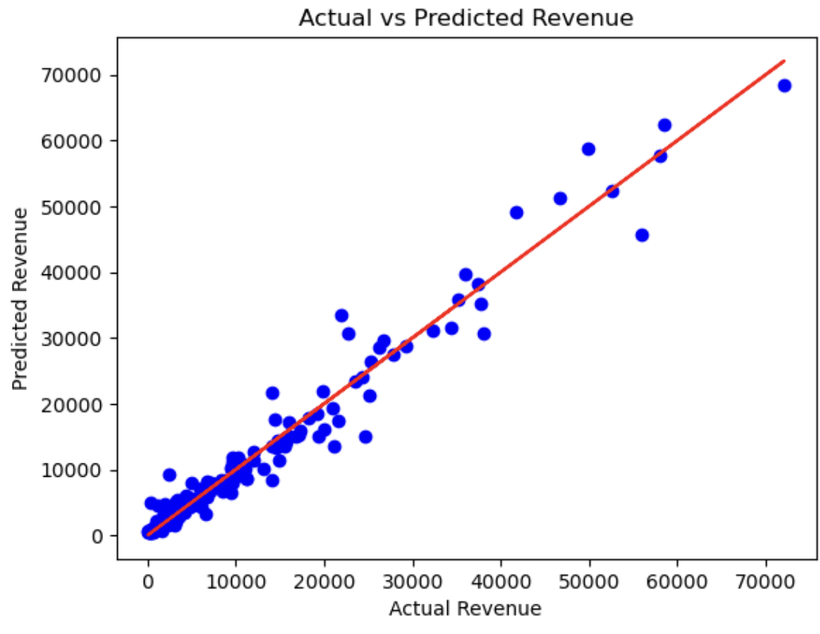

Slide 21
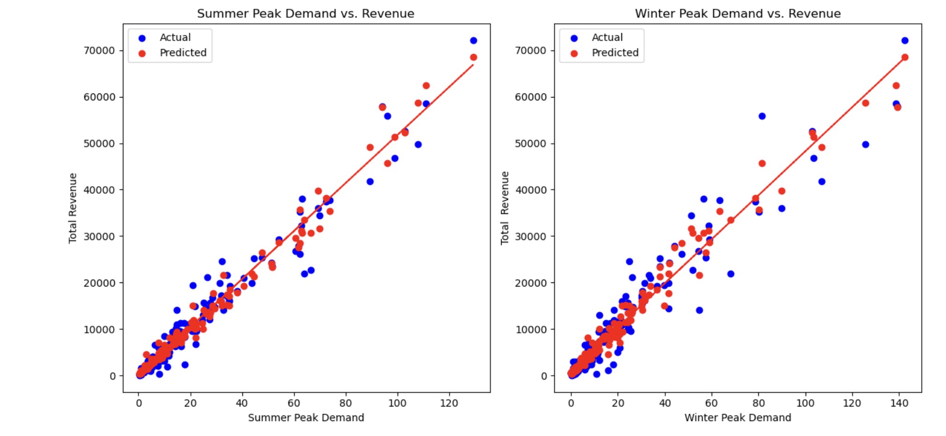

Slide 22
Conclusion
Findings represent a deeper understanding of our energy consumption patterns, highlighting opportunities for more efficient energy use and better utility management.
These insights are crucial in our path towards a more sustainable and energy-conscious future.

Slide 23

SOURCES/REFERENCES:
Kaggle Dataset - Link

Slide 24

Thank you!
Any Question/Feedback

